Slide 1
What is the importance of the Anterior Cruciate Ligament (ACL) in our bodies?
Laura Zwald

Slide 2
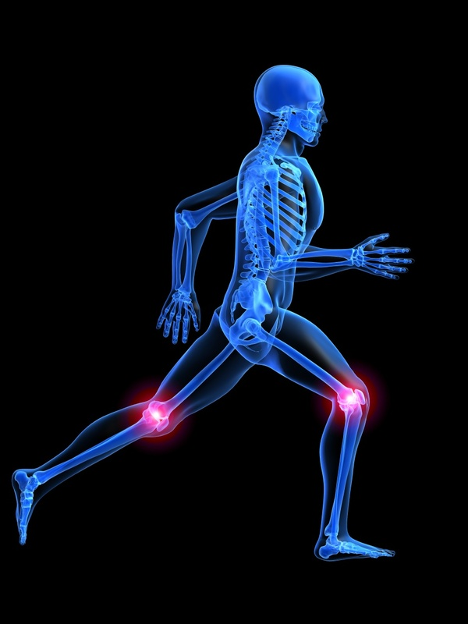
The ACL
The ACL prevents over use of certain parts of the knee, mainly anterior, in an assortment of degrees in flexion. In flexion of the knee, the anteromedial band of the ligament prevents anterior repositioning, and the posterolateral band maintains stability in the knee.
In simpler terms, it keeps the knee from hyperextending, limits excessive rotation, and helps restrain stresses on the knee; it connects the femur to the tibia.
The ACL acts as the central part of the knee that allows everything around to function properly and efficiently.
Once torn, it has the ability to wipe out an athletes career in sports and athletic activities.

Slide 3
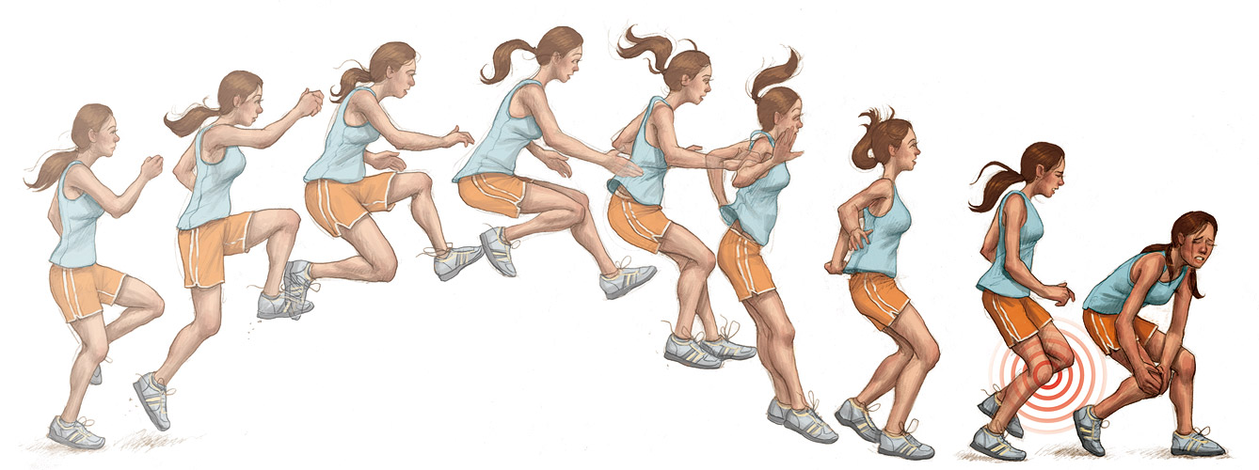
How do we tear the ACL?
The ACL has grown to be the most popular injury in the knee, especially among athletes and active humans, and have said to have more than 100,000 tears just in the United States per year.
The most common ways of tearing the ACL include quickly changing direction, sudden stopping, landing from a jump wrong, direct contact and collisions, and even slowing down while running.

Slide 4
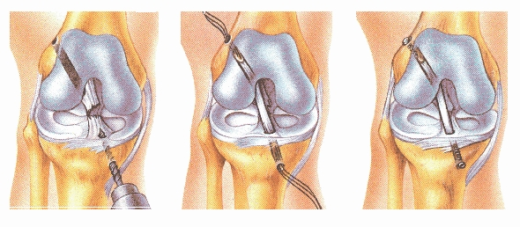
Surgery
Only two different types of surgery are typically performed: Patella Tendon and Hamstring Surgery.
For serious athletes, the Patella Tendon surgery is a must because these coaches demand it. This is only because the Patella Tendon only has a 6% chance of re-tearing while the Hamstring has an 8% chance.
The Patella Tendon surgery is much more strenuous and if not treated correctly after surgery. In order to reconstruct the ACL, the torn ACL is replaced with either small segments of the hamstring or patellar tendon to create a new ACL. Two incisions around your knee are made in order to put an arthroscope to see inside the joint followed by a sterile solution to enable a clear path. For the Patellar tendon surgery, surgeons use the middle third of the tendon and take out the torn, existing ACL. Small incisions are then drilled into the upper and lower leg bones around the knee joint. This allows the new ligament to screw into place.

Slide 5
Risk factors in Surgery
Every surgery has a risk of infection or bleeding, however for the ACL the rate of infection is only 0.2 percent and bleeding is less than one as well.
The most common complication would be loss of motion following the surgery, being very minor or dramatic. This is why rehabilitation is so vital to the ACL and must be started soon.
Some patients experience anterior knee pain as well after surgery, but this is mostly related to loss of motion.

Slide 6
Rehabilitation
Physical training has become essential to all injuries due to loss of strength, flexibility and it allows for the patient to fully recover and avoid future injuries.
Four to six months is the typical full recovery rate. However throughout those months, physical therapists and trainers are slowing increasing the motion, stability and strength in the knee and related muscles.
More confidence in the knee must be gained as well in order for the athlete to be able to perform with excellence. The process is lengthy and tedious but required to prevent another tear.

